Slide 1

Qualitative FAIR data workshop Template: Levels of processing and levels access
Research Support |University Library

Slide 2
Complete the table Fictional scenario: Qualitative Research on Urban Food Practices
Research Data Item(s)/files(s) | Processing Level | Possible Access Level
WhatsApp screenshots (.png) from participants sharing photos of their daily meals
Audio recording (.mp4) of kitchen tour with participant
Transcribed interview about food habits (.txt)
Spreadsheet with coded food categories across participants (.xls)
Atlas.ti project file with coding scheme on food security
Blog post summarizing community food stories
Presentation (.pptx) on food practices & urban inequality

Slide 3
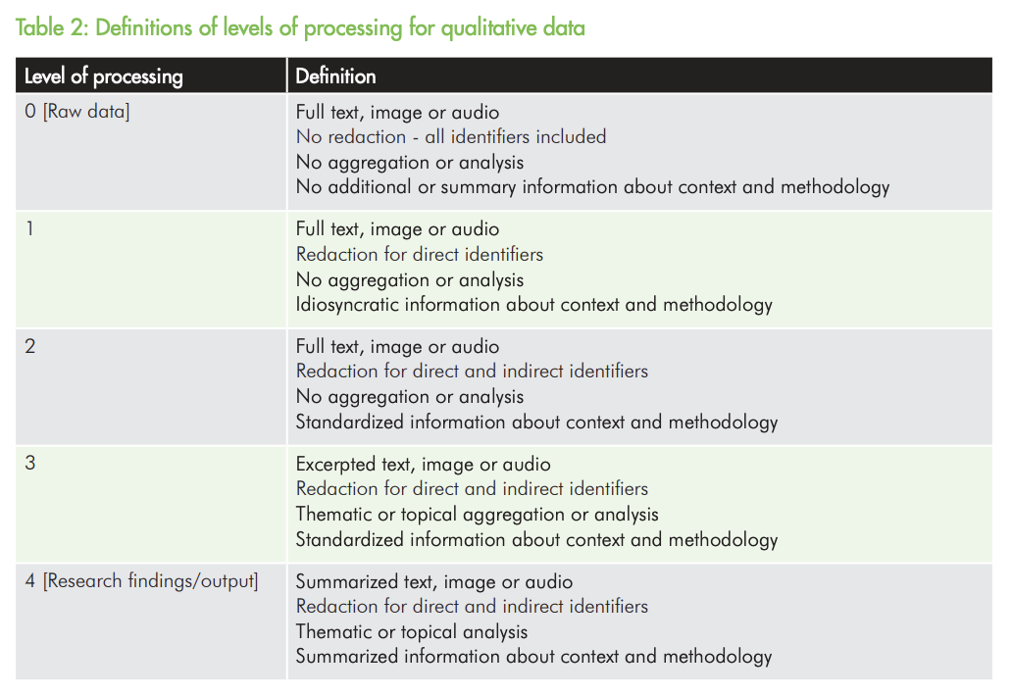
Jones & Alexander's classification
Notes:
Understanding the levels of processing we can define what files can we share and whichs ones cant
Branney: https://compass.onlinelibrary.wiley.com/doi/epdf/10.1111/spc3.12728

Slide 4
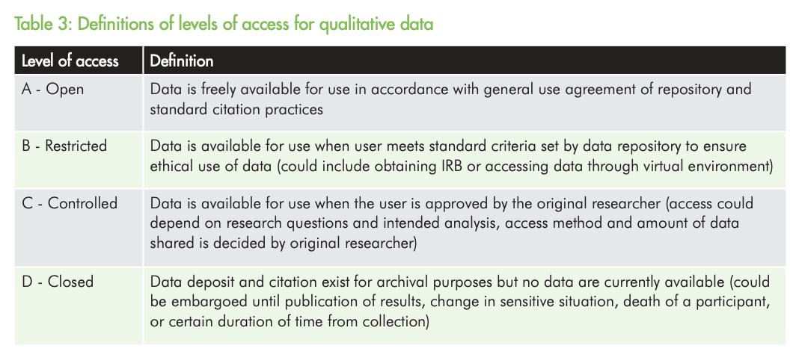
Jones & Alexander's classification
Jones, K., Alexander, S.M., et al. (2018). Qualitative data sharing and re-use for
socio-environmental systems research: A synthesis of opportunities, challenges, resources and approaches.
SESYNC White Paper. DOI:10.13016/M2WH2DG59
Notes:
Branney: https://compass.onlinelibrary.wiley.com/doi/epdf/10.1111/spc3.12728

